Slide 1

Understanding Implications of Build Options
Kevin Ford Magenic @Bowman74

Slide 2
Notes:
A picture of your average Xamarin developer

Slide 3
Things to Noodle Over
You Can’t Compile All Day Long
Link Like You Mean It
Playing with the Garbage
Don’t be So Nosey
Sign on the Dotted Line
Release the Kraken!
Notes:
What is the most effective debug configuration – fastest turn around time, is there a difference between VS and XS PC and Mac?
Linking settings to remove the most code – even if using a third party library
What options do you have to modify the GC?
Code obfuscation? Any options there?
Any options for signing? How about automation?

Slide 4
You Can’t Compile All Day Long

Slide 5
Where is My Time Being Spent?
Building the Assemblies?
Linking Away Unused Code
Packaging, Signing, etc?
Deploying to Device?
Depends?

Slide 6
Best Debug Configuration for Deployment Times - Android
Best Debug Configuration:
No Linking
Shared Runtime
Fast Deployment
Enable Developer Instrumentation
Seriously, that’s it…
Other Options up to 500-600% slower
Emulator 15% faster deploy time
Similar timings for Emulator in VS and XS

Slide 7
Best Debug Configuration for Deployment times - iOS
Best Debug Configuration - Simulator:
Best Debug Configuration - Device:
No Linking
Incremental Builds
Optimize Pngs
Linking Setting???
Incremental Builds
Optimize Pngs
Device Specific Builds
Profiling if needed - marginal impact
Simulator substantially faster than device (200%+ faster)
Xamarin Studio substantially faster than Visual Studio (100%+ faster)

Slide 8
Link It Like You Mean It
Notes:
https://bugzilla.xamarin.com/show_bug.cgi?id=36577

Slide 9
Linking Effects
Mono SDK and Safe Libraries
Your Code
Unsafe Third Party Libraries
No Linking
73.18 MB
Link SDKs Only
31.38 MB
Link All
25.7 MB
Notes:
https://bugzilla.xamarin.com/show_bug.cgi?id=36577

Slide 10
Linking Methods
Attributes in Code
Your Code
Reference Directly In Code
Your Code and Third Party
Project Properties – Link Skipping
Third Party

Slide 11
Preservation Attributes - PCL
public sealed class PreserveAttribute : System.Attribute
{
public bool AllMembers;
public bool Conditional;
}
[assembly:LinkerSafe]
public sealed class LinkerSafeAttribute : System.Attribute
{
public LinkerSafeAttribute() : base() {}
}

Slide 12
Preserved Class
[Preserve(Conditional=true)] public class TestClass { [Preserve] public TestClass() {} [Preserve] public string GetSharedText() { return "good"; } public string LinkAway() { return string.Empty; } }

Slide 13
Reference Directly in Code
// Never call this class or anything in it
public class LinkerPleaseInclude { public void Include(TestClass testClass) { var a = testClass.GetSharedText(); var b = new TestClass(); } }

Slide 14
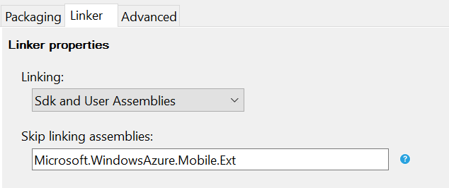
Project Properties - Android
Visual Studio
Xamarin Studio

Slide 15
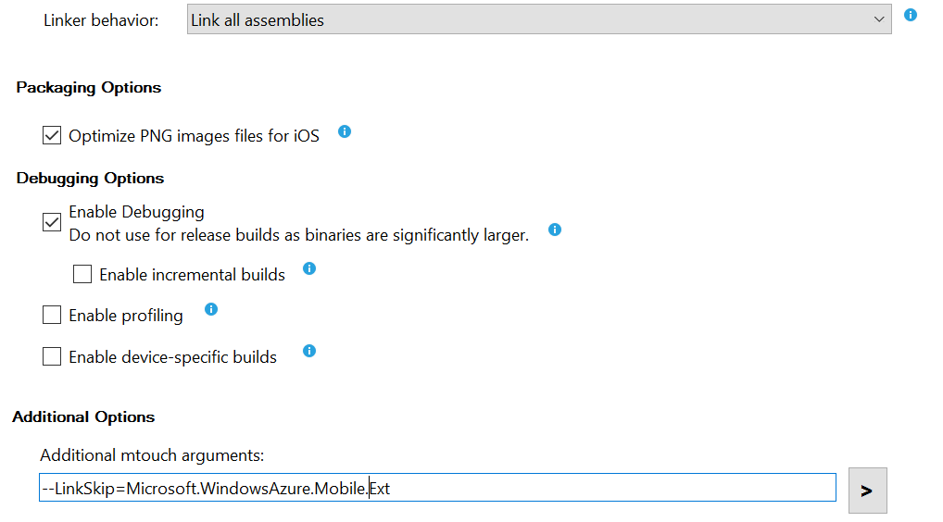
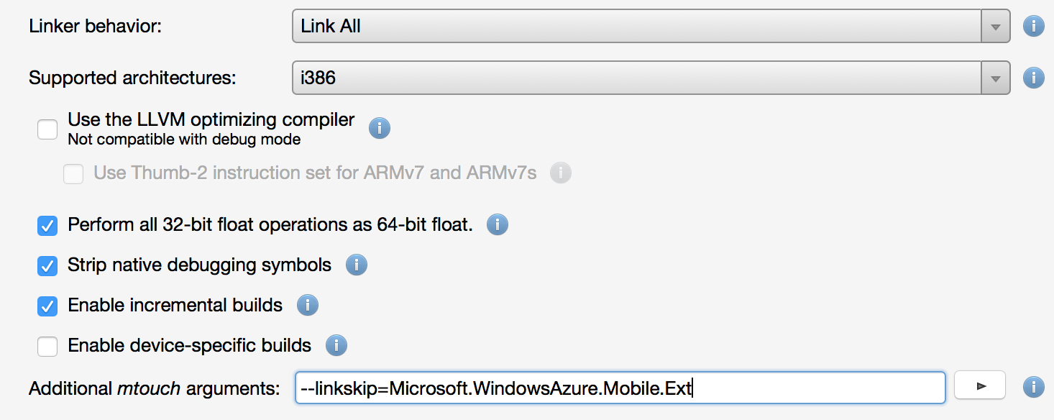
Project Properties - iOS
Visual Studio
Xamarin Studio

Slide 16
Playing with the Garbage

Slide 17
Mono SGen Garbage Collector
Generational Garbage Collector
Major vs. Minor Collections
Nursery
Major Heap (Old Generations)
Large Object Space
Stop the World
The More you Allocate, the More Minor GC

Slide 18
Minor Collection
Nursery
Old Generations
Object A
Existing Object
X
Object B
Object B
Object C
X

Slide 19
But You Can Play with It - MONO_GC_PARAMS
nursery-size
soft-heap-limit
evacuation-threshold
bridge-implementation - old , new , tarjan
Notes:
http://www.mono-project.com/docs/advanced/garbage-collector/sgen/
Nursery-size – change size of nursery default is 4m measured in k, m and g (kilo, mega, giga)
soft-heap-limit – target memory size, when below less GC when above more GC
evacuation-threshold - int 0-100, default 66. if occupancy % in memory block is less that this amount it will compress memory to make it contiguous
bridge-implementation – bridge between managed and platform code.

Slide 20
Don’t be So Nosey

Slide 21
Android Options
Embed Assemblies in Native Code
APK files are just zips
All Assemblies by default are bundled into APK
Assemblies can easily be opened in a look like Dot-Peek
Converted into Binary goo as .so file in Lib directory
Requires MSDN enterprise
AOT Option Does Not Remove .Net Assemblies
Proguard
Minimizes and obfuscates the Java Code
No spaces allowed in path to Android SDK
This won’t matter if you can’t embed assemblies in native code
These Options will Only Slow Down
Someone Reverse Engineering Your Code
Notes:
Third party companies

Slide 22
What if I Don’t Have the MSDN Enterprise?
Don’t Panic
Other Obfuscation Tools Available
Crypto Obfuscator
Xenocode
ConfuserEx
Or, Just Purchase MSDN Enterprise
Seriously, Your Time is Worth Something
Notes:
http://forums.xamarin.com/discussion/24396/obfuscation-and-manually-sign-an-apk

Slide 23
iOS Options
Your Code is AOT Compiled
Not much that needs to be done here out of the box
No .Net Assemblies to pull out of the .ipa
This will Only Slow Down Someone Reverse
Engineering Your Code
If You Need More, Third Party Firms Can Help

Slide 24
Sign on the Dotted Line

Slide 25
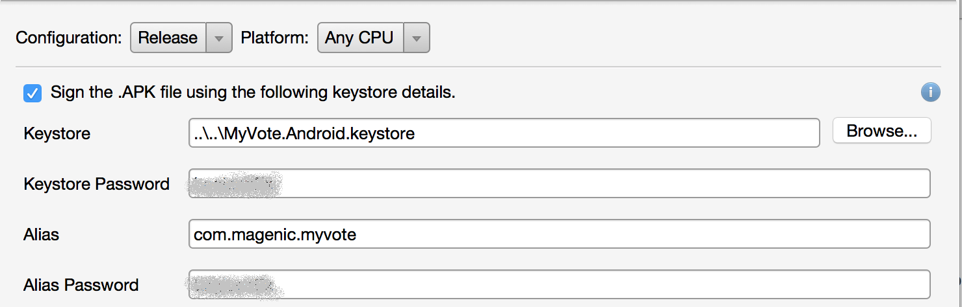
Xamarin Studio

Slide 26
Visual Studio
<AndroidSigningKeyStore>..\..\MyVote.Android.keystore</AndroidSigningKeyStore> <AndroidSigningStorePass>SomePassword</AndroidSigningStorePass> <AndroidSigningKeyAlias>com.magenic.myvote</AndroidSigningKeyAlias> <AndroidSigningKeyPass>SomePassword</AndroidSigningKeyPass> <AndroidKeyStore>True</AndroidKeyStore>

Slide 28
Android Release Options
Link SDK and User Assemblies if Possible
Embed Assemblies in Native Code
Enable Proguard
MSDN Enterprise Features - Preview
Enable AOT
Use LLVM Optimizing Compiler
Supported ABIs
Notes:
LLVM http://www.mono-project.cohttps://developer.xamarin.com/guides/android/deployment,_testing,_and_metrics/publishing_an_application/part_1_-_preparing_an_application_for_release/
m/docs/advanced/mono-llvm/

Slide 29
Android Release Options - Continued
Conditionally Turn on
Enable Multi-Dex
Generate one package (.apk) per selected ABI
Internationalization
Java heap size
Uncompressed resource extensions
Absolutely Should Be Turned Off
Use shared Mono Runtime
Fast assembly deployment
Enable Developer Instrumentation
Notes:
https://developer.android.com/tools/building/multidex.html
Java Head size to increase memory for build

Slide 30
iOS Release Options
Link SDK and User Assemblies if Possible
LLVM Optimizing Compiler
Strip Native Debug Symbols
Optimize png images for iOS
Supported Architectures
Use Sgen generational Garbage Collector

Slide 31
iOS Release Options - Continued
Conditionally Turn on
Thumb-2 instruction set
Perform 32 bit float operations as 64 bit
Internationalization code sets
Absolutely Should Be Turned Off
Enable incremental builds
Enable device-specific builds
Enable Debugging
Enable Profiling
Notes:
http://wanderingcoder.net/2010/07/19/ought-arm/ can use thumb-2 when targeting ARMv7 and ARMv7s. Much smaller binary
https://developer.xamarin.com/guides/ios/advanced_topics/compiling_for_different_devices/

Slide 32
Thanks!!!
Kevin Ford
@Bowman74
http://windingroadway.blogspot.com/

